Slide 2
Sets Everywhere!
#Data17
Alex Wheeler
Product Consultant
Conor Knowles
Senior Product Consultant

Slide 3
Alex Wheeler
#Data17
Last time in Vegas, Dixie Chicks bought me a round
Responsible for alcohol being sold in the University of Texas Football Stadium
I have a twin sister who is an elephant zookeeper

Slide 4
Alex Wheeler
#Data17
Last time in Vegas, Dixie Chicks bought me a round
Responsible for alcohol being sold in the University of Texas Football Stadium
I have a twin sister who is an elephant zookeeper

Slide 5
Conor Knowles
#Data17
I watched all 62 episodes of Breaking Bad in three days
Tom Hanks was at my house while filming Castaway
I carry the title of “Lord”

Slide 6
Conor Knowles
#Data17
I watched all 62 episodes of Breaking Bad in three days
Tom Hanks was at my house while filming Castaway
I carry the title of “Lord”

Slide 7
Agenda
What are Sets?
Different Ways to Create Sets
Manual Set
Conditional Set
Calculated Set
Sets By Filter
Combined Set
What You Can Do After You’ve Created Sets
Notes:
Creation of Sets is easy…this session is about the after…why would you do that and how is it helpful?

Slide 8
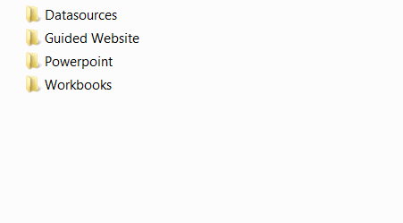
Materials

Slide 9
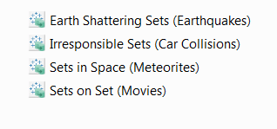
Materials

Slide 10

Materials

Slide 11
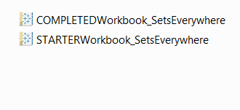
Materials

Slide 12
Lets Talk About Sets
What are Sets in Tableau
Sets are custom fields that define a subset of data based on some conditions
They can be based on a computed condition or specific data points on your view
You can even combine multiple sets
There are some date periods you cannot group with, but can create sets
How are Sets different than Groups
Sets can combine dimensions into a single list and be based on measure values
Groups combine members into many lists within a single dimension

Slide 13
Earth Shattering Sets
Exercise #1

Slide 14
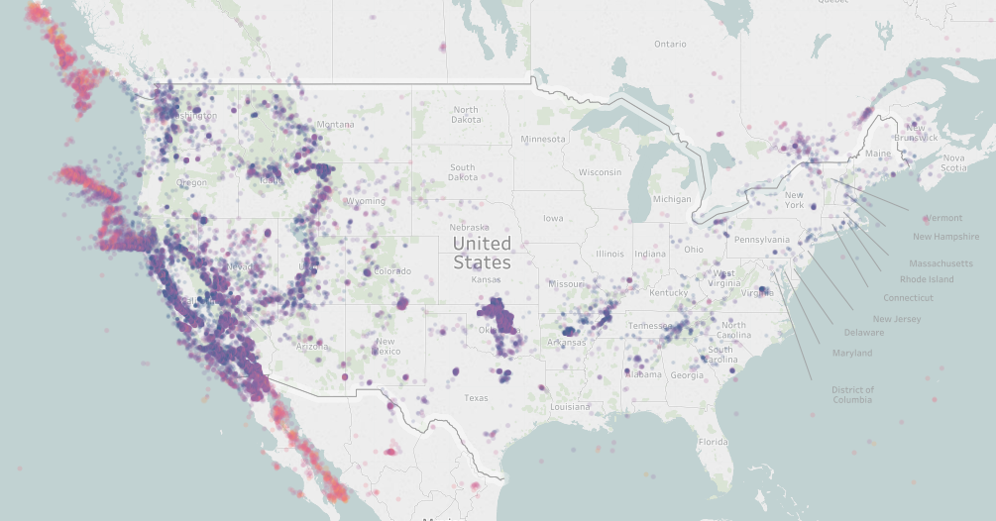
Challenge #1
Create a Set manually by selecting earthquakes within the US with the lasso selector

Slide 15
But why would we do this?
We can now use this Set to add, remove, or highlight data points in our analysis
Lets create some things together!

Slide 16
Exercise #1b

Slide 17
Why use Sets
Dynamic or Static
Sets update as your data changes
Alternatively, a Set can be based on specific data point in your view
Flexible
Use cases in most visualizations
Can be changed at any time
Additive
More information-dense presentations
Complimentary/used in actions
Fast
In view, near instant response rate
Powerful
Depth of analysis
Row level security

Slide 18
I’ve attended TC 5 years in a row now, and never thought to attend this session. [Sets] will save me hundreds of thousands of dollars
Anonymous attendee from TC16 Non-profit analytics

Slide 19
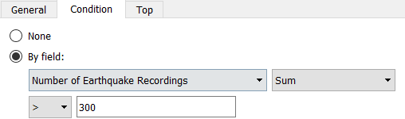
How We Use Sets
Let’s create a conditional Set and see which days experienced more than 300 earthquakes

Slide 20
Exercise #2

Slide 21
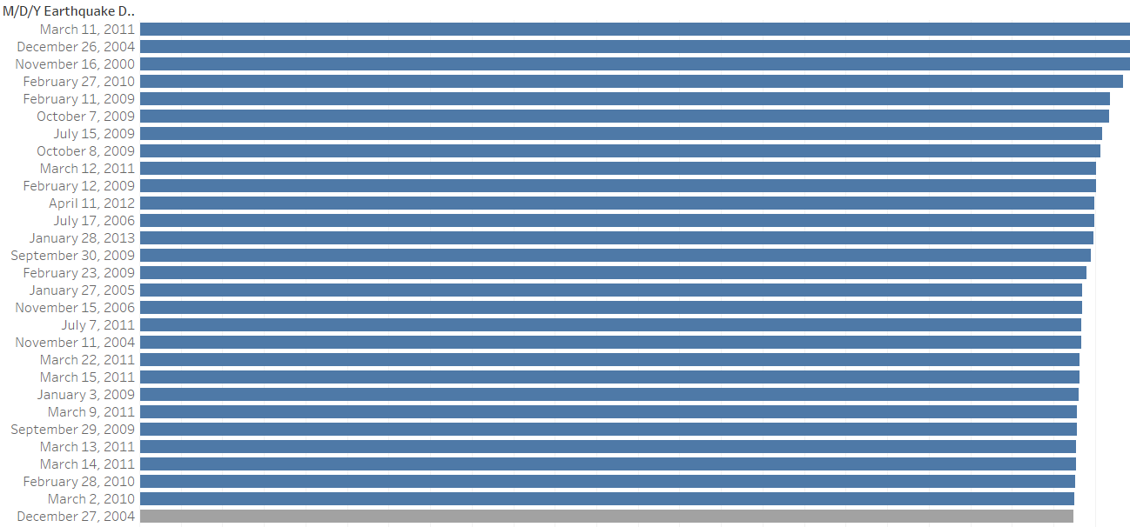
Challenge #2
Create a conditional Set based on the days which experienced a higher average than a 4.5 magnitude earthquake.
Bonus: create a parameter that allows you to change the average magnitude

Slide 22
Exercise #3

Slide 23
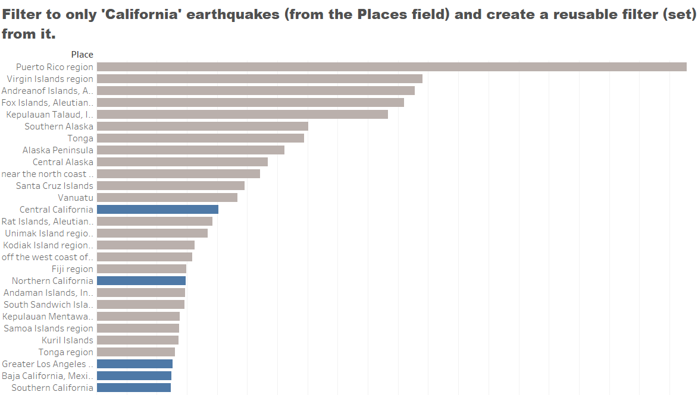
Challenge #3
Filter to only 'California' earthquakes (from the Places field) and create a reusable filter (Set) from it.

Slide 24
Break

Slide 25
Sets…. In…..
You! (probably)
SPACE!!!

Slide 26
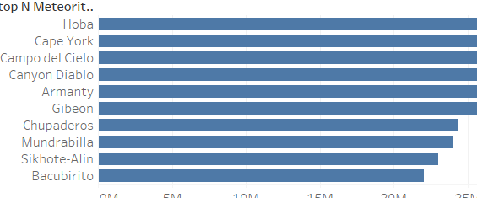
SURPRISE CHALLENGE #4

Slide 27
Different use cases Map layers
Exercise #4

Slide 28
Sets On Set

Slide 29
Exercise #5

Slide 30
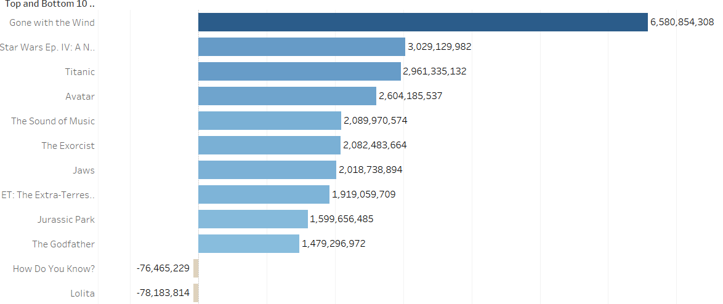
Challenge #5
Show the top 10 and bottom 10 actors by average profitability of their movies

Slide 31
Exercise #6

Slide 32
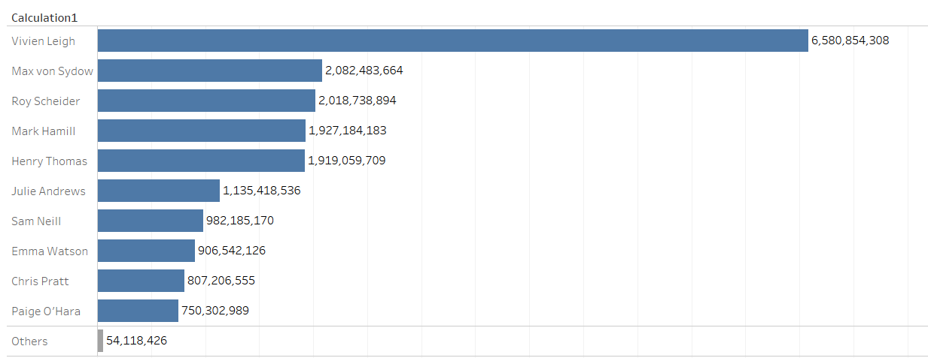
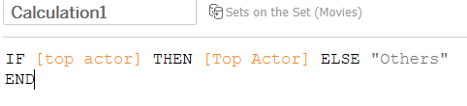
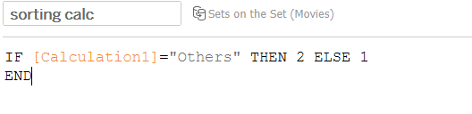
Create a calculation that allows us to see the Top Actors by AVG Adjusted Profit displayed and all other Actors averaged together (Bonus: Get 'Others' to always show on the bottom)
Challenge #6

Slide 33
Sets in New York

Slide 34
How You Can Use Sets Now
So many options!
Group variables manually by existing dimensions, by a common condition, by a given ranking
Create calculations based on these Sets
Combine Sets to group by multiple variables
Use Sets for advanced calculations and fast analysis

Slide 35

Diving Off The Deep End

Slide 36
deeper

Slide 37
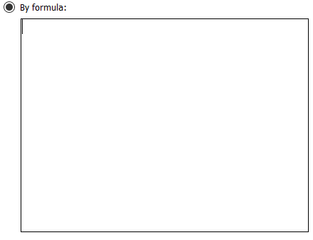
And then there are Jedis

Slide 38
In order to dynamically answer
How do I find the customers that ordered from this category but not this one?
How do I find the customers that ordered in 2012 and in 2013?
What students received an A in Biology but a B in Geometry?

Slide 39
Can be answered statically, but what about quickly and dynamically? What if I want to continue analysis with these Sets?

Slide 40
The Conditional Calculation
Rules
Has to be boolean
Have to aggregate

Slide 41
The Conditional Calculation
Tips
Piece out each part
Test frequently and often
Is it boolean?

Slide 42

Final Challenge

Slide 43
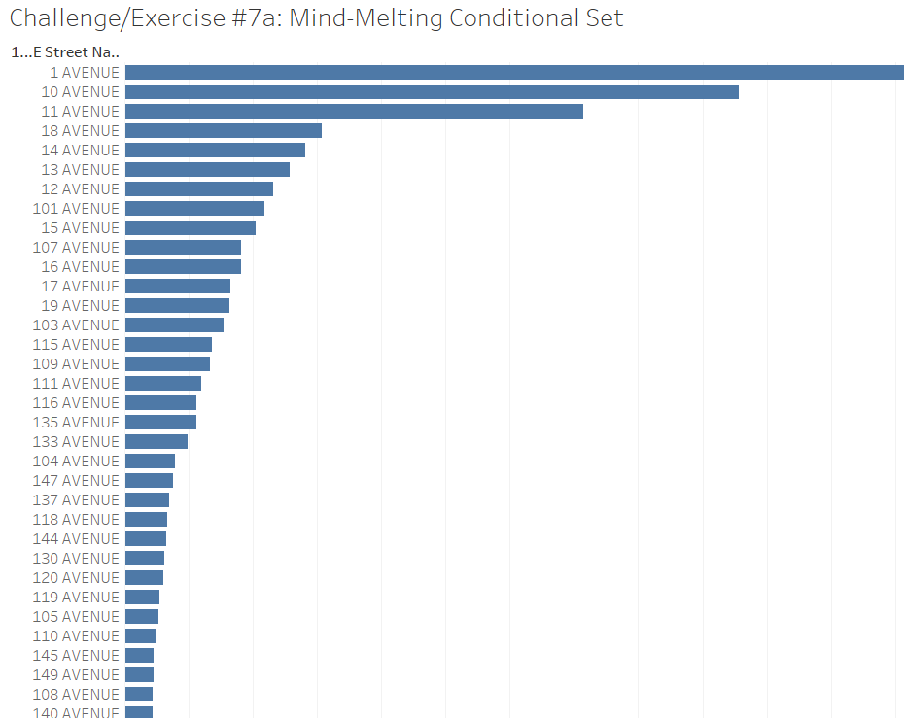
Create a Set that only displays Street Names that:
Start with a “1”
End with an “E”
(e.g. 1st Avenue)
IIF(Left([Street Names],1)="1",1,0)
+
IIF(Right([Street Names],1)="e",1,0)=2

Slide 44


Slide 45
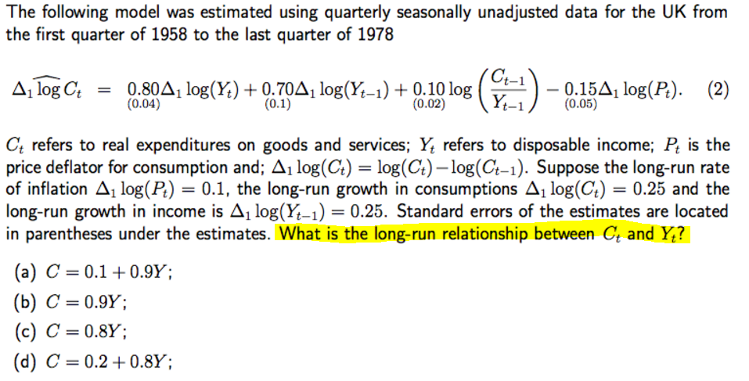
Just kidding.

Slide 46
But Now Parameterize And Map The Calc

Slide 47
SESSION REPEATS
Wednesday, October 11 Sets Everywhere
1:30pm – 4:00pm | South – L3 – South Seas H
Thursday, October 12 Sets Everywhere
10:30am – 1:00pm | North – South Pacific H

Slide 48
RELATED SESSIONS
Wednesday, October 11 Parameters: Driving Interactivity One Dashboard at a Time
1:30pm – 4:00pm | South – L2 – Mandalay Bay D
Wednesday, October 11 Dining with Tableau Filters
10:15am – 12:45pm | North – South Pacific D
Thursday, October 12 Intro to Calculations: Estimating the Airspeed Velocity of an Unladen Swallow
10:30am – 1:00pm | North – Islander G

Slide 49
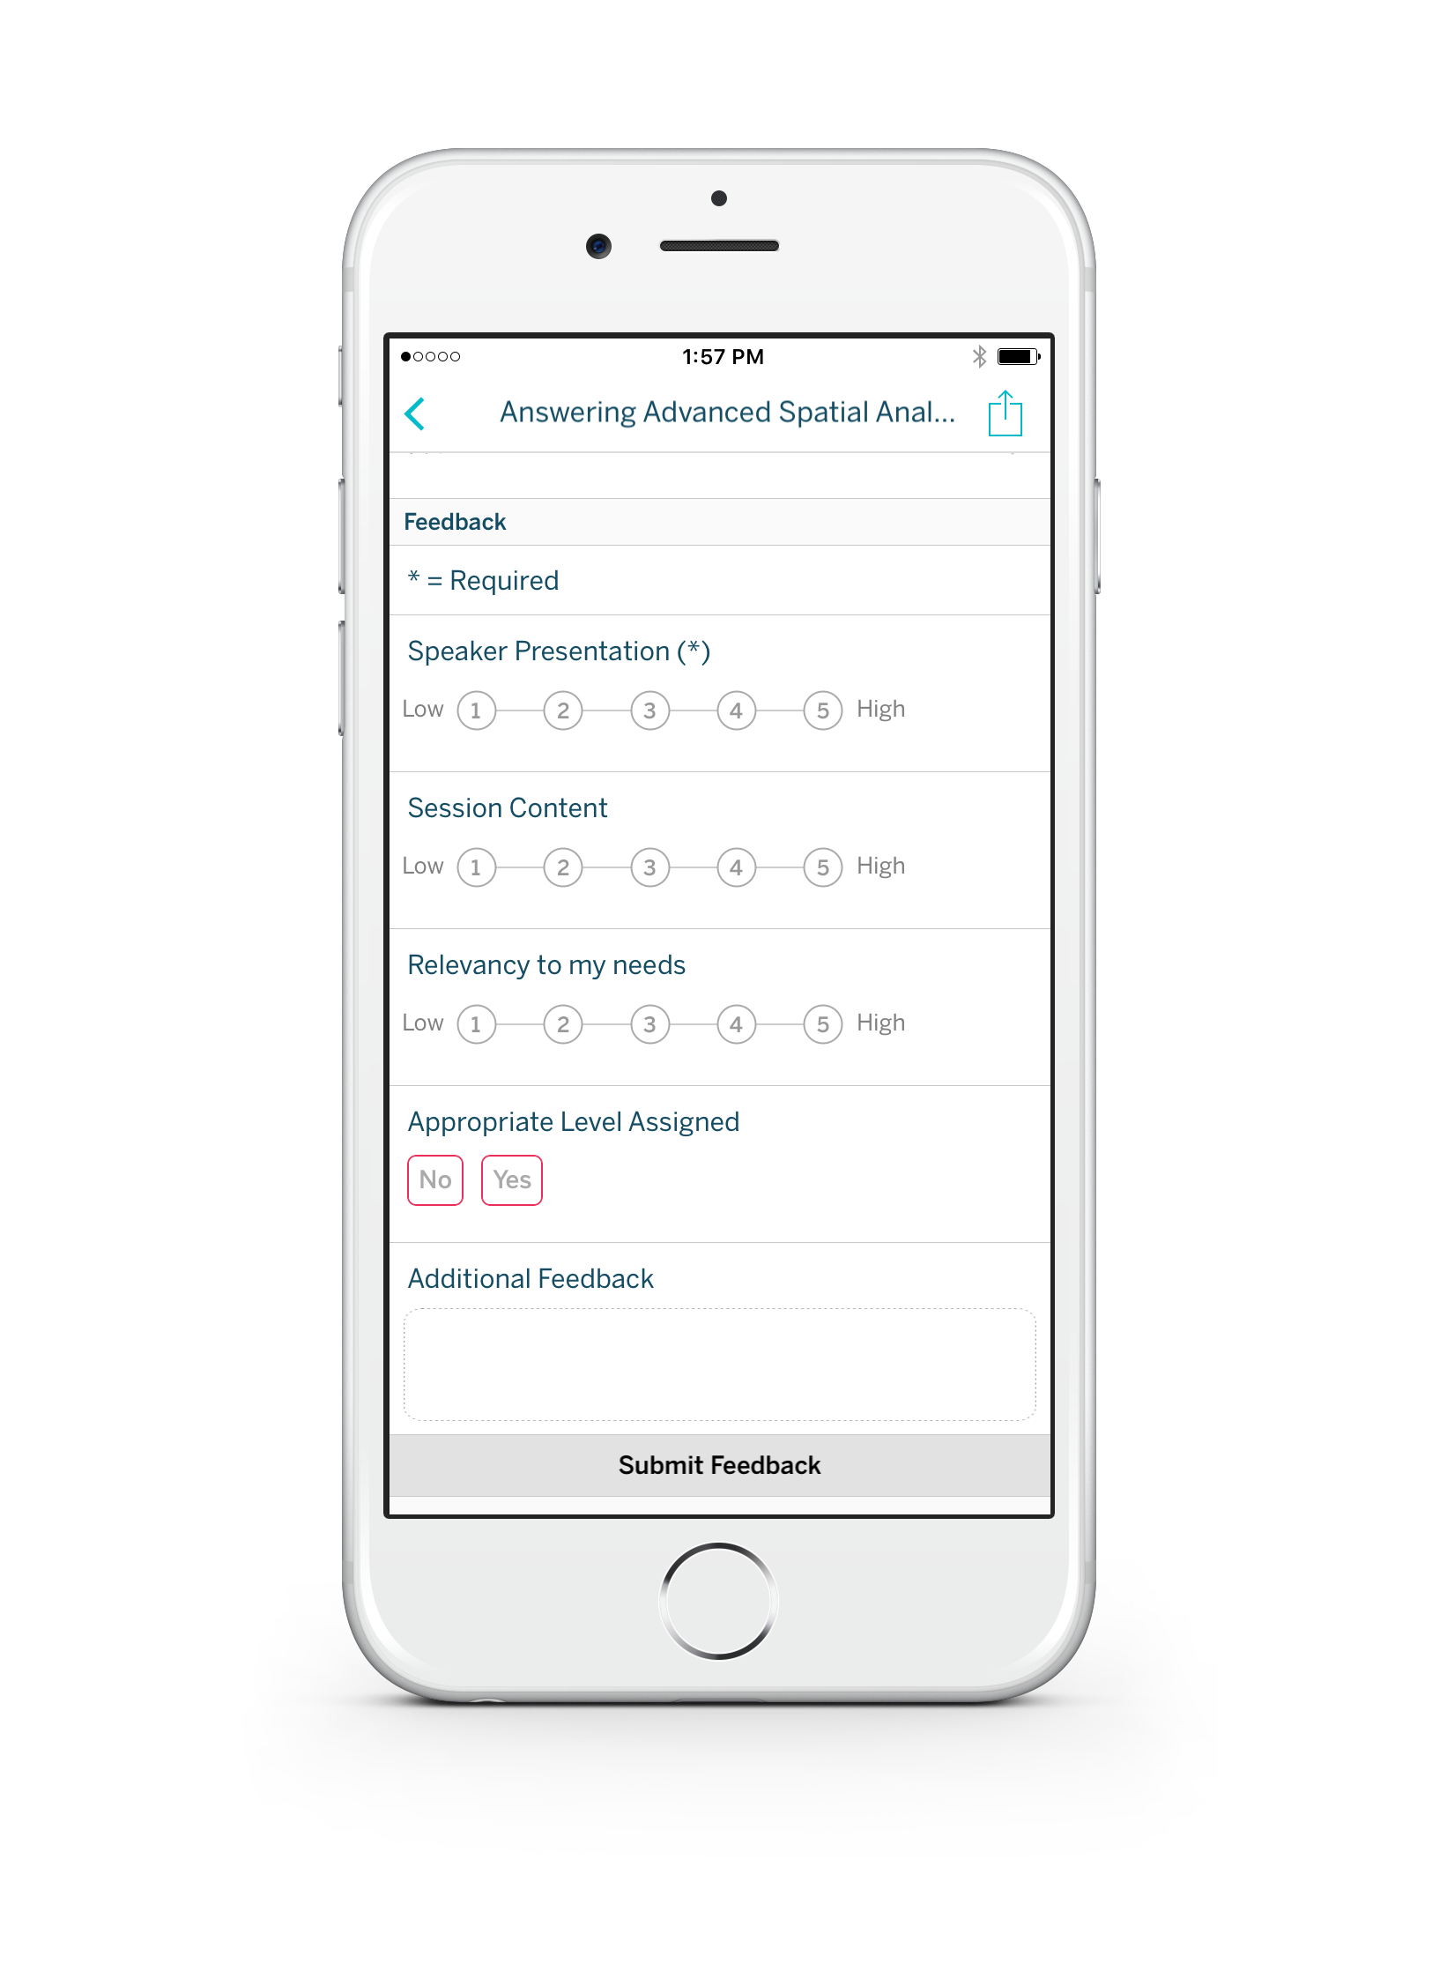
Please complete the session survey from the Session Details screen in your TC17 app

Slide 50
Please complete the session survey from the Session Details screen in your TC17 app

